Slide 1
Design and Analysis of Algorithms
CS602
Lecture 5
Divide and Conquer Paradigm – III
- Finding Majority Element
Greedy paradigm - I

Slide 2
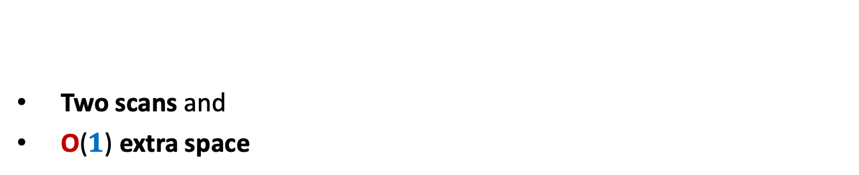
algorithm for 2-majority element
Homework from last class
Two scans and
O($1$) extra space

Slide 3

Designing algorithm for 2-majority element $2$ scans and using O($1$) extra space
Insightful questions
scan
$a b c c c z c a b b c c c c d c$

Slide 4
Designing algorithm for 2-majority element $2$ scans and using O($1$) extra space
Insightful questions:
Do we really need to keep more than one element ?
Do we really need to keep multiple copies of an element explicitly ?
These insights underlie the desired algorithm ☺
scan
$a b c c c z c a b b c c c c d c$
No. Just cancel suitably whenever encounter two distinct elements.
No. Just keeping its count will suffice.

Slide 5




The Algorithm
$a b c c c z c a b b c c c c d c$
$$c$$
$$c$$
$$c$$
$$a$$

Slide 6

The Algorithm
$a b c c c z c a b b c c c c d c$
$$c$$
$$c$$
$$c$$

Slide 7

The Algorithm
$a b c c c z c a b b c c c c d c$
$$c$$
$$c$$
$$c$$

Slide 8


The Algorithm
$a b c c c z c a b b c c c c d c$
$$c$$
$$c$$
$$c$$
$$(3)$$

Slide 9

The Algorithm
$a b c c c z c a b b c c c c d c$
$$c$$
$$(3)$$
$$(2)$$

Slide 10


The Algorithm
$a b c c c z c a b b c c c c d c$
$$c$$
$$(2)$$
$$(3)$$
Can you see the algorithm now ?.

Slide 11
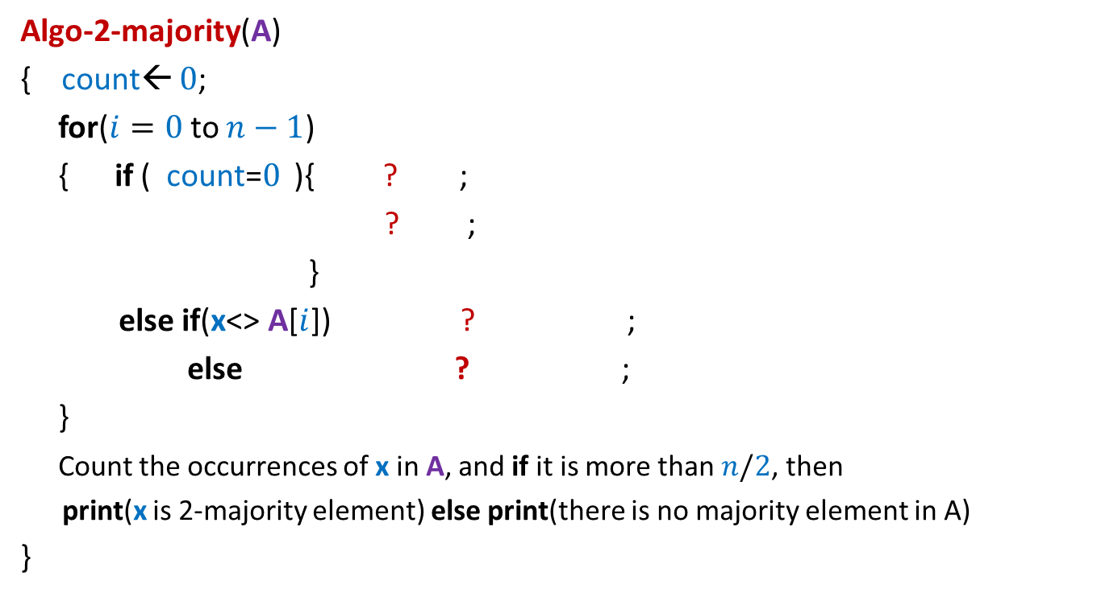


Algorithm for 2-majority element $2$ scans and using O($1$) extra space
Algo-2-majority(A)
{ count← $0$;
for($i=0$to $n−1$)
{ if ( count=$0$ ){ ? ;
? ;
}
else if(x<> A[$i$]) ? ;
else ? ;
}
Count the occurrences of x in A, and if it is more than $n/2$, then
print(x is 2-majority element) else print(there is no majority element in A)
}
x← A[$i$];
count← 1;
count ← count - 1
count← count + 1

Slide 12
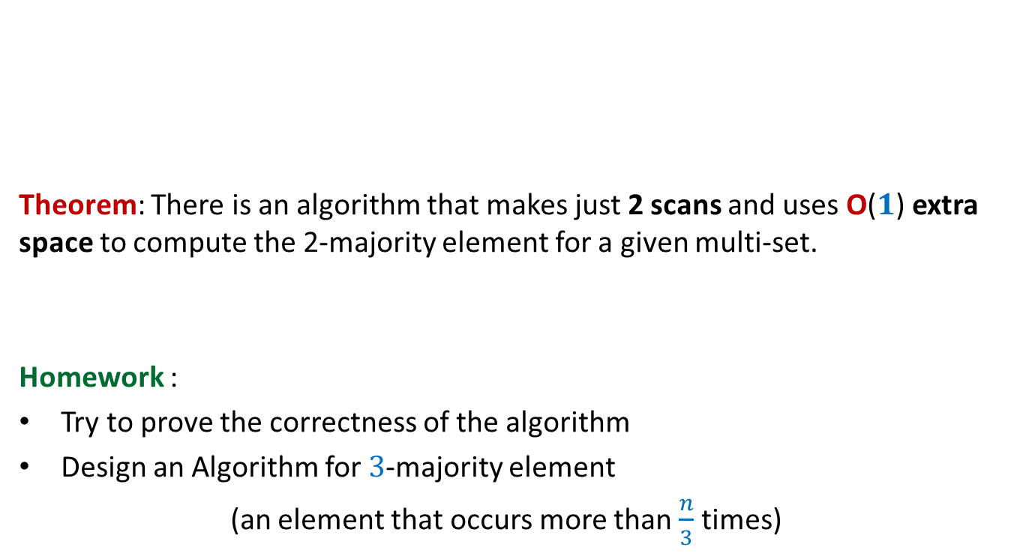
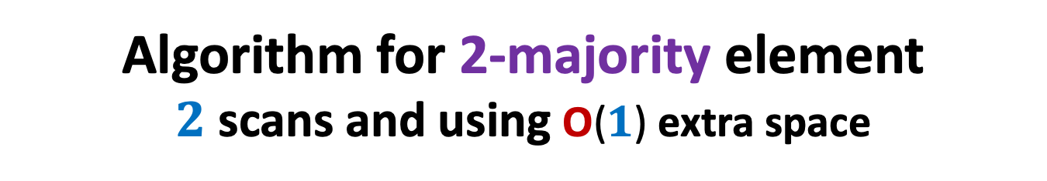
Algorithm for 2-majority element $2$ scans and using O($1$) extra space
Theorem: There is an algorithm that makes just 2 scans and uses O($1$) extra space to compute the 2-majority element for a given multi-set.
Homework :
Try to prove the correctness of the algorithm
Design an Algorithm for $3$-majority element
(an element that occurs more than $\frac{n}{3}$ times)

Slide 13

Path to the algorithm of a problem
Examples
intuition/insight
Strategy
Have perseverance
Failure ☹
Better Insight ☺
No formula
But there is a systematic approach which usually works ☺
Success ☺

Slide 14
Today’s lecture will demonstrate this approach ☺
Problem : JOB Scheduling
Largest subset of non-overlapping job

Slide 15
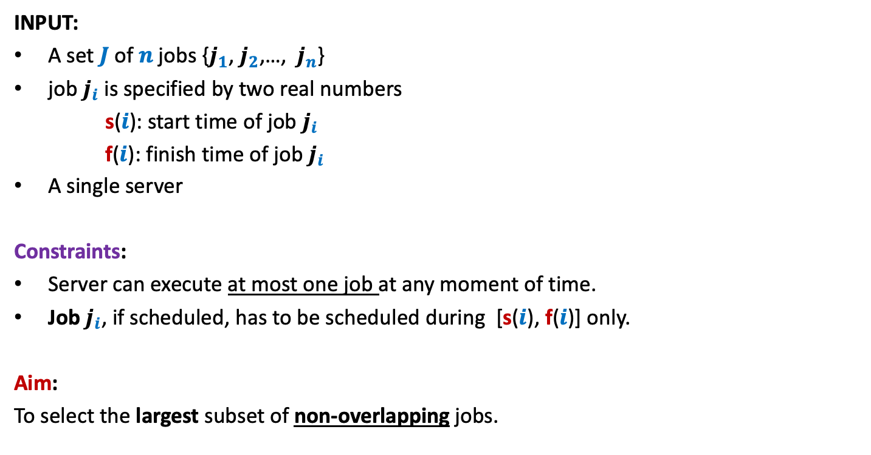
A job scheduling problem
Formal Description
INPUT:
A set $J$of $n$ jobs {$j_{1}$, $j_{2}$,…, $j_{n}$}
job $j_{i}$ is specified by two real numbers
s($i$): start time of job $j_{i}$
f($i$): finish time of job $j_{i}$
A single server
Constraints:
Server can execute at most one job at any moment of time.
Job $j_{i}$, if scheduled, has to be scheduled during [s($i$), f($i$)] only.
Aim:
To select the largest subset of non-overlapping jobs.

Slide 16

Example
INPUT: ($1$, $2$), ($1.2$, $2.8$), ($1.8$, $4.6$), ($2.1$, $3$), ($3$, $5$), ($3.3$, $4.2$), ($3.9$, $4.4$), ($4.3$, $5.4$)
job $i$ is said to be non-overlapping with job $k$if [s($i$), f($i$)] ∩[s($k$), f($k$)] = ∅
0 1 2 3 4 5 6 7
It makes sense to work with pictures than these numbers☺
Try to find solution for the above example.

Slide 17
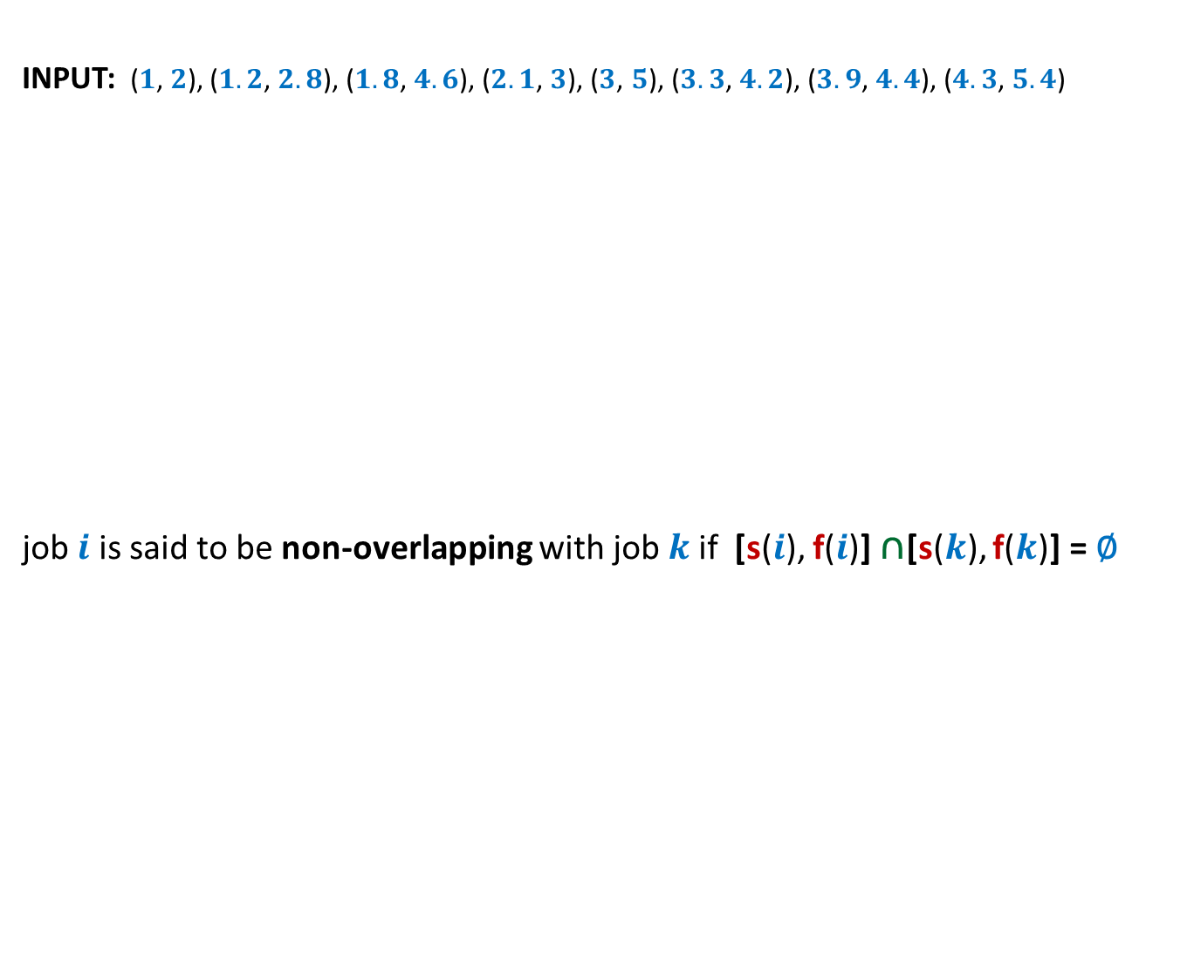
Example
INPUT: ($1$, $2$), ($1.2$, $2.8$), ($1.8$, $4.6$), ($2.1$, $3$), ($3$, $5$), ($3.3$, $4.2$), ($3.9$, $4.4$), ($4.3$, $5.4$)
job $i$ is said to be non-overlapping with job $k$if [s($i$), f($i$)] ∩[s($k$), f($k$)] = ∅
0 1 2 3 4 5 6 7
What strategy come to your mind?

Slide 18
Designing algorithm for any problem
Choose a strategy based on some intuition
Transform the strategy into an algorithm.
Try to prove
correctness
of the
algorithm
c
Try to design a
conterexample
c
Stop as soon as either of these goals is reached

Slide 19
Designing algorithm for the problem
Strategy 1: Select the earliest start time job
Intuition:
It might be better to assign jobs as early as possible so as to make optimum use of server.
0 1 2 3 4 5 6 7
When one fails to prove the correctness of this strategy, one should search for a counterexample. Can you transform the above example into a counterexample ?

Slide 20
Designing algorithm for the problem
Strategy 1: Select the earliest start time job
Intuition:
It might be better to assign jobs as early as possible so as to make optimum use of server.
0 1 2 3 4 5 6 7

Slide 21
Designing algorithm for the problem
Strategy 1: Select the earliest start time job
Intuition:
It might be better to assign jobs as early as possible so as to make optimum use of server.
0 1 2 3 4 5 6 7
Instead of getting disappointed, try to realize that this counterexample points towards some other strategy which might work.
counterexample. ☹

Slide 22
Designing algorithm for the problem
Strategy 2: Select the job with smallest duration
Intuition:
Such a job will make least use of the server
➔ this might lead to larger number of jobs to be executed
0 1 2 3 4 5 6 7
When one fails to prove the correctness of this strategy, one should search for a counterexample. Can you transform the above example into a counterexample ?

Slide 23
Designing algorithm for the problem
Strategy 2: Select the job with smallest duration
Intuition:
Such a job will make least use of the server
➔ this might lead to larger number of jobs to be executed
0 1 2 3 4 5 6 7
Instead of getting disappointed, try to realize that this counterexample points towards some other strategy which might work.
counterexample. ☹

Slide 24
Designing algorithm for the problem
Strategy 3: Select the job with smallest no. of overlaps
Intuition:
Selecting such a job will result in least number of other jobs to be discarded.
0 1 2 3 4 5 6 7
When one fails to prove the correctness of this strategy, one should search for a counterexample. Can you transform the above example into a counterexample ?

Slide 25
Designing algorithm for the problem
Strategy 3: Select the job with smallest no. of overlaps
Intuition:
Selecting such a job will result in least number of other jobs to be discarded.
0 1 2 3 4 5 6 7
counterexample.

Slide 26
Designing algorithm for the problem
Strategy 4: Select the job with earliest finish time
Intuition:
Selecting such a job will free the server earliest
➔ hence more no. of jobs might get scheduled.
0 1 2 3 4 5 6 7

Slide 27
Designing algorithm for the problem
Strategy 4: Select the job with earliest finish time
Intuition:
Selecting such a job will free the server earliest
➔ hence more no. of jobs might get scheduled.
0 1 2 3 4 5 6 7

Slide 28
Designing algorithm for the problem
Strategy 4: Select the job with earliest finish time
Intuition:
Selecting such a job will free the server earliest
➔ hence more no. of jobs might get scheduled.
0 1 2 3 4 5 6 7

Slide 29
Designing algorithm for the problem
Strategy 4: Select the job with earliest finish time
Intuition:
Selecting such a job will free the server earliest
➔ hence more no. of jobs might get scheduled.
0 1 2 3 4 5 6 7
It is indeed a correct solution for this example. We should try to prove the correctness of the algorithm.☺But first we give a full description of the algorithm based on this strategy.

Slide 30
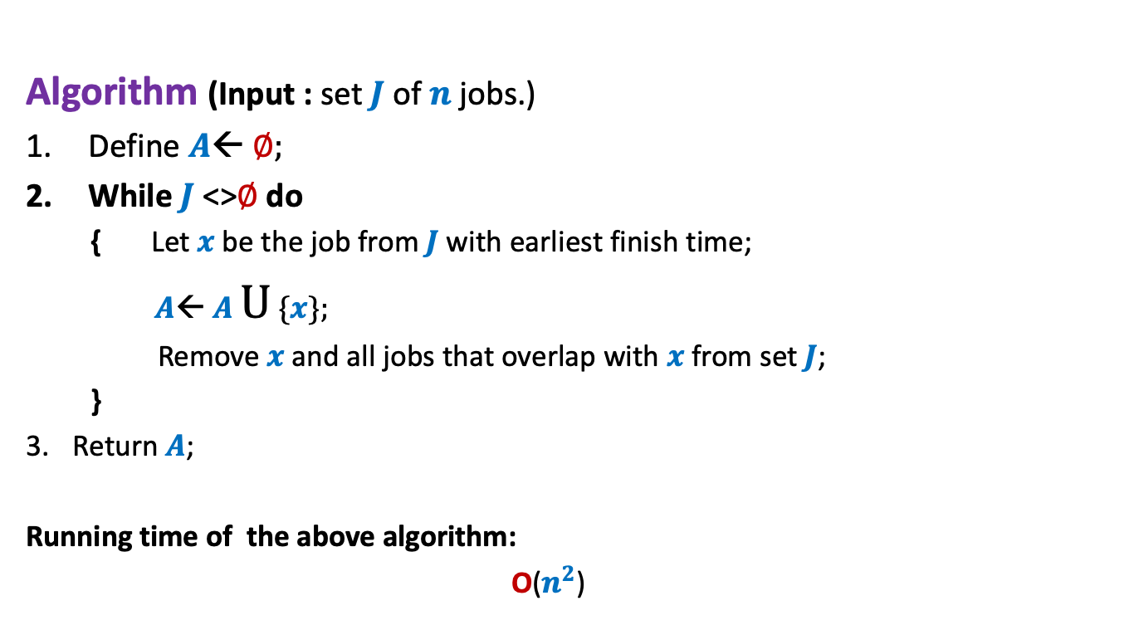
Algorithm “earliest finish time” Description
Algorithm (Input : set $J$of $n$ jobs.)
Define $A$← ∅;
While $J$<>∅ do
{ Let $x$be the job from $J$with earliest finish time;
$A$← $A$ U {$x$};
Remove $x$and all jobs that overlap with $x$from set $J$;
}
Return $A$;
Running time of the above algorithm:
O($n^{2}$)

Slide 31

Algorithm “earliest finish time” Correctness
Let $x$ be the job with earliest finish time.
Lemma1: $x$is present in the optimal solution for $J$.
Too strong a claim !
Wrong
0 1 2 3 4 5 6 7

Slide 32
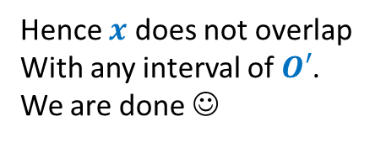






Algorithm “earliest finish time” Correctness
Let $x$ be the job with earliest finish time.
Lemma1: There exists an optimal solution for $J$in which $x$is present.
Proof: Consider any optimal solution $O$ for $J$. Let us suppose $x$∉ $O$.
Let $y$ be the job from $O$ with earliest finish time.
Let $O′$← $O\backslash \{y\}$
$O^{′}∪\{x\}$ is also an optimal solution.
Reason: $O^{′}∪\{x\}$ has no overlapping intervals. Give arguments.
➔f($x$) $≤$ f($y$)
➔f($y$) < s($z$) $∀$ $z∈$ $O′$
➔f($x$) < s($z$) $∀$ $z∈$ $O′$
$$x$$
Hence $x$ does not overlap
With any interval of $O′$.
We are done ☺
$$y$$
0 1 2 3 4 5 6 7

Slide 33

Homework
Design an O($n$log $n$) implementation of the algorithm.

Slide 34
Another Job scheduling problem

Slide 35





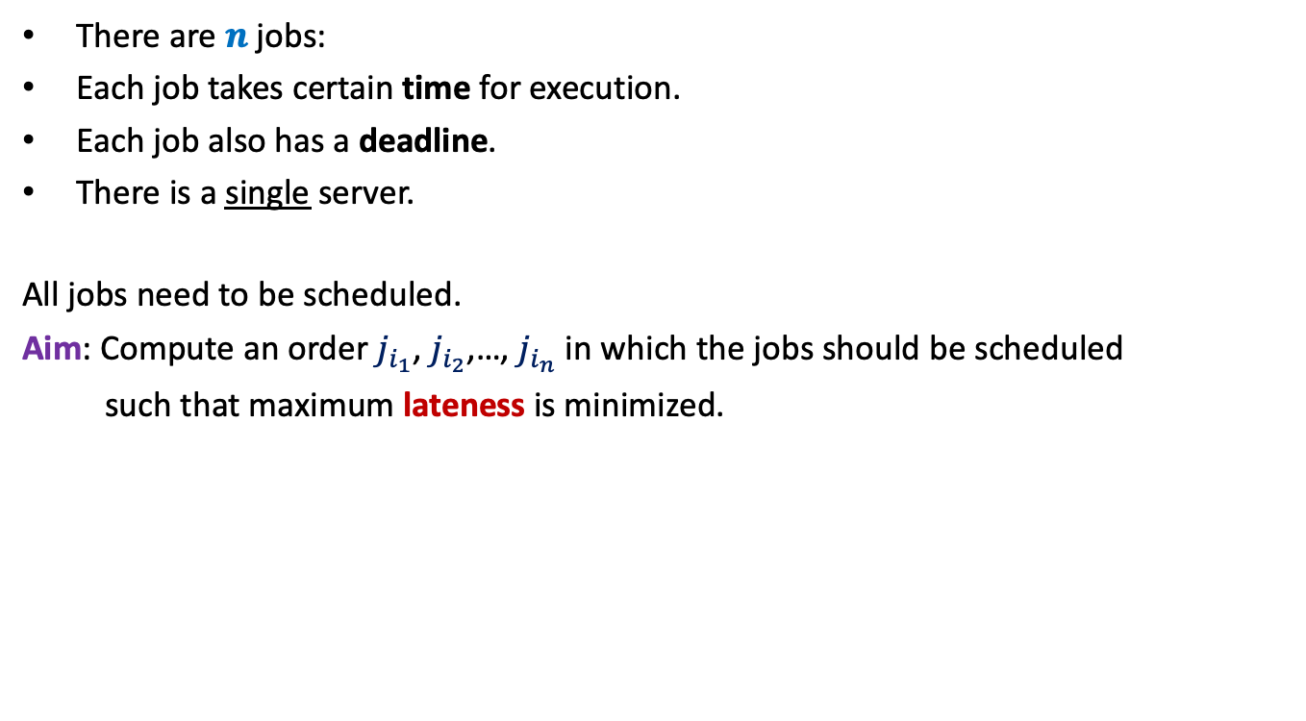








There are $n$ jobs:
Each job takes certain time for execution.
Each job also has a deadline.
There is a single server.
All jobs need to be scheduled.
Aim: Compute an order $j_{i_{1}}$, $j_{i_{2}}$,…, $j_{i_{n}}$ in which the jobs should be scheduled
such that maximum lateness is minimized.
$j_{1}$, $j_{2}$,…, $j_{n}$
Job $j_{i}$ takes $t_{i}$ time
Job $j_{i}$ has deadline $d_{i}$
$$f_{i_{k}}$$
$$d_{i_{k}}$$
$$d_{i_{k}}$$
Lateness of $j_{i_{k}}$
$$j_{i_{1}}$$
$$j_{i_{2}}$$
$$j_{i_{3}}$$
$$j_{i_{k}}$$
$$j_{i_{n}}$$
$$0$$
time

Slide 36

Towards designing an algorithm
Each job $j_{i}$ has two parameters
Time of execution $t_{i}$
Deadline $d_{i}$
Idea 1: Schedule the jobs in the increasing order of Time of execution.
Try to prove correctness
Try to come up with a counter example

Slide 37
Homework from 2nd lecture
Transform the common man’s algorithm to just 1 round ?
Analyse the common man’s algorithm. In particular, try to prove its correctness.

Slide 38
Real challenge of multiple merit lists

Slide 39

Multiple merit lists
 | $$1$$ | $$2$$ | $$3$$
IIT
NIT
ARCH
 | $$1$$ | $$2$$ | $$3$$
A
B
C
C B A
IIT
ARCH
NIT
A C B
NIT
IIT
ARCH
B A C
ARCH
NIT
IIT
Merit Lists
Choice Lists
A
B
C
Allocation $1$
Allocation $2$
Allocation $3$
IIT
NIT
ARCH
IIT
NIT
ARCH
IIT
NIT
ARCH
C
A
B
A
B
C
B
C
A
Candidate Pessimal
Candidate Optimal

Slide 40
Homework
Which allocation does the software industry’s algorithm output ?
Candidate Optimal
Candidate Pessimal
None of the above
Ponder over it …
Design an algorithm that outputs the candidate optimal allocation.
Does such an allocation even exist ?

